Slide 1
CLOSING THE CARBON CYCLE PETER EISENBERGER AIR CAPTURE: DEVELOPING TECHNOLOGIES FOR CARBON RECYCLING AND NEGATIVE EMISSIONS 16 October 2012, London

Slide 2
CLOSING THE CARBON CYCLE A NECESSARY CONDITION FOR SUSTAINABILITY
THE CHALLENGES WE FACE
THE CARBON CYCLE
HOW DOES NATURE CLOSE THE CARBON
OUR SPECIES CAN CLOSETHE CARBON CYCLE
A SOLUTION

Slide 3
THE CHALLENGES WE FACE
MEETING BASIC NEEDS+ OF 9 BILLION PEOPLE
ENERGY SECURITY
LOCALLY PRODUCED GLOBALLY AVAILABLE
5-10X SUPPLY
SUSTAINABLE
ECONOMIC DEVELOPMENT
OVERCOME DEVELOPED/DEVELOPING COUNTRY DIVIDE
ELIMINATE POVERTY
CLIMATE CHANGE PROTECTION
CLOSE THE CARBON CYCLE
FLEXIBILITY TO ADJUST ATMOSPHERIC CONCENTRATION
CLOSING THE CARBON CYCLE IS NEEDED
AND
CO2 FROM AIR IS PART OF IT

Slide 4
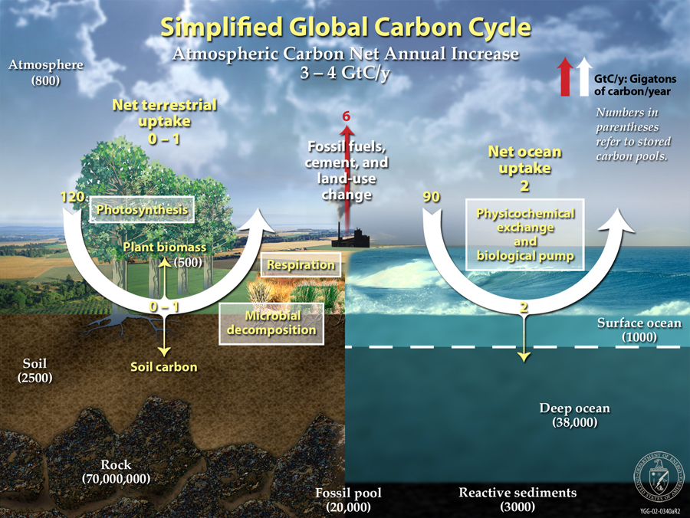
Notes:
Snapshot of carbon cycle
Note positve input of humans of 6 gigatonnes of carbon about 24 gigatonnes of co2
Note large fluxes of co2 between the land and air and the sea and air – natural balance today is to reduce co2 –global cooling period
Note today 3-2 gigatonnes of our contribution adsorbed by rest of system that will change over time could aggravate problem grealty –would effecively double the rate of increase- nature changes the balance on its own and destructively so
But even in this fortunate situation our current approach will not work

Slide 5
OBSERVATIONS
CARBON CYCLE NOT CLOSED
OCEAN SEQUESTERING CO2- ABOUT 1%
CHANGES SIGN WITH TIME
ESSENTIAL TO HAVE LONG TERM STABILITY
HUMAN CONTRIBUTION
ONLY 3% OF CO2 FLUX
UNIDIRECTIONAL
NO LONG TERM STABILITY
PHOTOSYNTHESIS 1-3 % EFFICIENT SOLAR ENERGY
FITNESS - RESILIENCE NOT EFFICIENCY
HUMAN DESIGNED SOLAR
MORE EFFICIENT AND MORE RESILIENT – COST

Slide 6
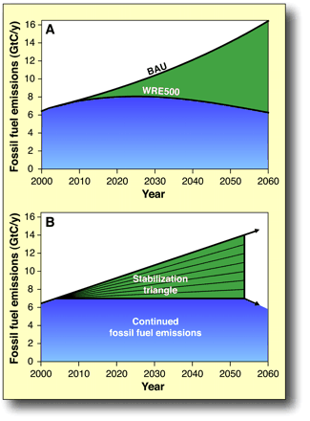
Current Approaches to Manage Our Carbon
“Wedges” approach a good start…
Sensible, diversified strategy based on existing pathways
Portfolio of renewable energy and efficiency technologies
Potential to keep CO₂ below 500ppm (still 2x pre-indust. level)
But may not be enough to avoid climate change…
Depends on continued net natural absorption rate
Does not address 2000’s already elevated emissions
Underestimates projected growth rate by factor of two
No solution past 2055
Climate will change destructively on its own
Earth history has many climate disasters
New York City under a 1 mile high ice sheet
A safe, effective, and affordable solution to climate change is still urgently needed
Notes:
2005 pacala and socolow
As a detailed analysis shows will not prevent co2 from increasing –bathtub model

Slide 7
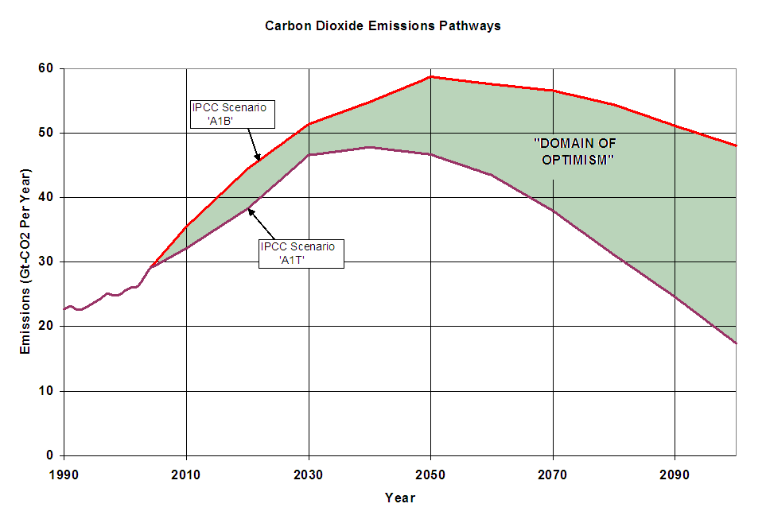
Emissions Scenarios…

Slide 8
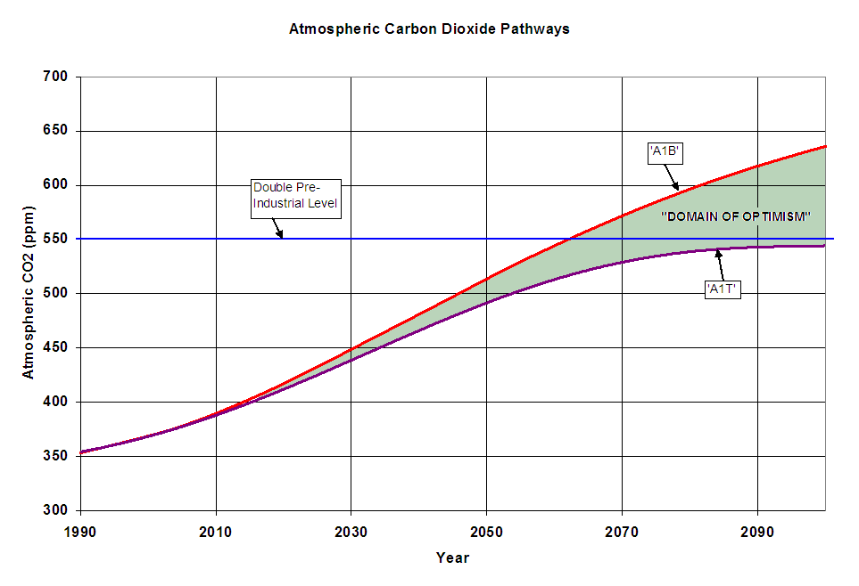
Future Atmospheric Concentrations…
Notes:
Too small
Maybe bullet or two

Slide 9
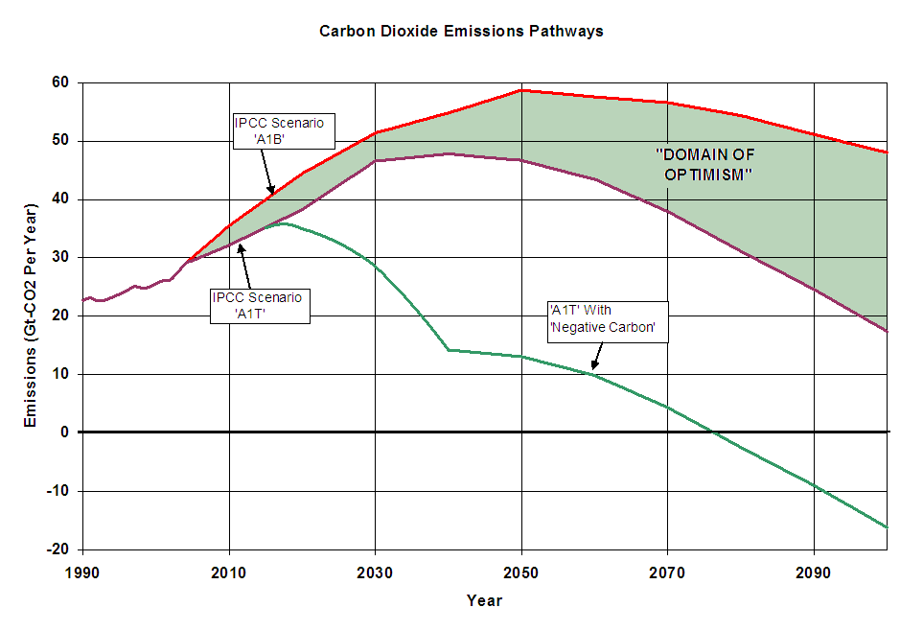
What Carbon Negative Can Achieve…

Slide 10
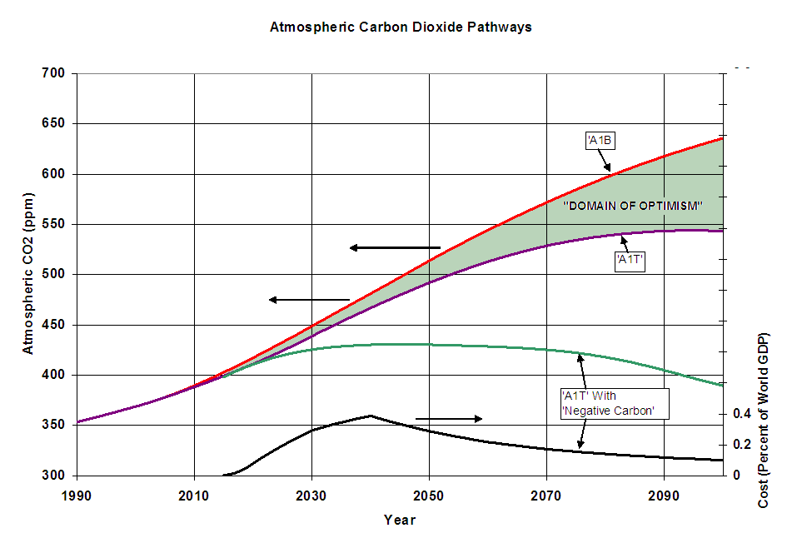
The Cost of Atmospheric CO2…

Slide 11
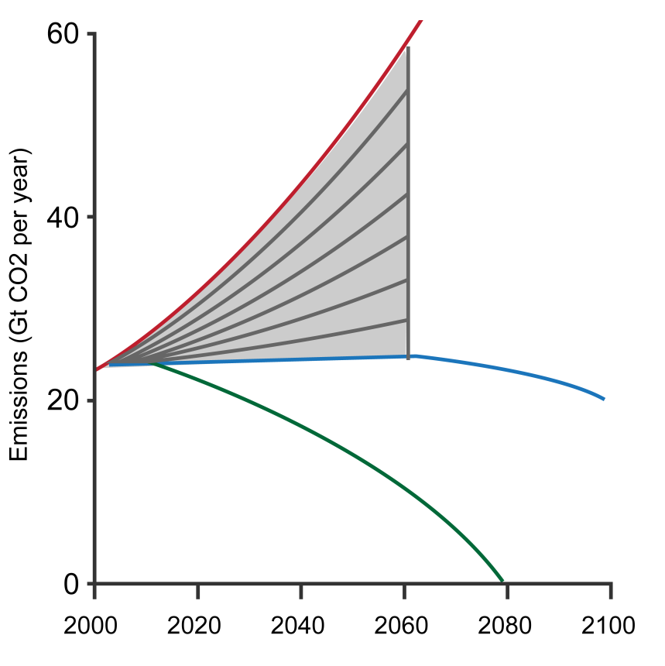
The Need for Going Carbon Negative…
Carbon Neutral is not enough
Neutralizing new and existing emissions does not prevent atmospheric concentration of CO2 from further increasing
It doesn’t solve the climate risk problem (reducing atmospheric concentrations below 500 ppm)
Carbon-Negative Required
To reduce atmospheric concentrations faster than the natural absorption rate
To achieve a safe level of CO2 concentration
Air Capture Can Make Going Carbon Negative Possible
Business as usual
7 Wedges (aggressive renewable energy use, efficiency, point-source sequestration)
Negative Carbon Technology (such as Global Thermostat) with aggressive renewable energy
Pacala and Socolow, Science, Vol 305, 8/13/2004, Pg 969.
Note: 7 Wedges refers to the seven stabilization wedges, created by Wigley, Richels & Edmonds, necessary to achieve an atmospheric concentration of CO2 of 500 ppm by 2125.
Notes:
Bathtub explanation –will not solve climate problem or address underlying energy security and economic development components of sustainability

Slide 12
OUR CARBON BASED SPECIES CAN CLOSE THE CARBON CYCLE
A BI-DIRECTIONAL CARBON BASED ENERGY PROCESS
ENERGY SOURCE
INPUT CO2 FROM THE AIR AND HYDROGEN FROM WATER
PRODUCED USING SOLAR ENERGY
RELEASING CO2 AND WATER WHEN COMBUSTED
TWO PROCESSES
BIOMEMETIC/ ALGAE + SOLAR+ CO2 FROM AIR
INDUSTRIAL/ ELECTROLSIS +SOLAR + CO2 FROM AIR

Slide 13
GT Project with Algae Systems
GT is developing a fully-integrated biorefinery through a partnership with Algae Systems
Produces carbon negative transportation fuels (diesel, jet, etc)
Treats municipal wastewater and produces drinking water
Generates green electricity and biochar fertilizers
CO₂
Solar Energy
Algae Production
Dewatering
Fuel Production
Fuels,
Electricity &
Biochar
Wastewater
Treated
Wastewater
Desalination
Drinking
Water
This unique combination of technologies provides critical municipal services while producing energy in an embodiment that is
As Green As It Gets

Slide 14
CO2 FROM AIR ELECTROLYSIS :HYDROGEN FROM WATER The Production of Methanol is a Proven Technology
COCCCO2CO₂ + co2+3H23H₂
CO2+3H2 TO CH3OH +H20
The above reaction is exothermic, DH298=-49.47 kJ/mol
This reaction is faster than conventional methanol processes that use synthesis gas (CO + H2)

Slide 15
CO₂ and Methanol to Gasoline Process Chemistry Has Been Commercially Proven with Favorable Energy Characteristics
3H₂O 3H₂ + 3/2O₂
CO₂ + 3H₂ CH₃OH + H₂O
CH₃OH n-CH₂- + H₂O
_______________________________
3H₂O + CO₂ n-CH₂- + 3/2O₂ + 2H₂O overall reaction
ΔH_{373 K}= 40.79kJ/mol heat of vaporization of water at 100 C
ΔH_{reaction} = -49.47kJ/mol heat of reaction to form methanol
ΔH_{reaction} = -48.32kJ/mol heat of reaction for methanol to gasoline

Slide 16
Renewable 95: Closing the Carbon Cycle
CONVERTING CO₂ FROM AIR & HYDROGEN FROM WATER
TO
95 OCTANE GASOLINE
Water Vapor and CO₂
CO2 Capture
&
Hydrogen Conversion
95
Octane
Notes:
Tech pathways to harvest atmosphere—create value in closed loop

Slide 17
TECHNOLOGY CHARACTERISTICS
POWERED BY SUN
ESSENTAILLY UNLIMITED SOURCE
LIQUID FUEL PRODUCT STORES ENERGY
ADDRESSES INTERMITTENCY OF SOLAR ENERGY
LOCALLY PRODUCED GLOBALLY
ENERGY SECURITY FOR ALL
DROP IN TECHNOLOGY
MINIMIZES INFRASTRUCTURE COSTS
ENERGY EFFCIENT AND RESILIENT
“COST” IS THE ISSUE

Slide 18
“COST” OF ENERGY
“COST” = PRIVATE COST+ EXTERNAL COST=SOCIAL COST
PRIVATE COST=WHAT YOU PAY AT THE PUMP OR FOR ELECTRICITY
EXTERNAL COST ARE THOSE NOT REFLECTED IN MARKET
SUBSIDIES
HEALTH LIABILITIES
ENVIRONMENTAL DAMAGES/CLIMATE CHANGE
ENERGY/ OIL-RELATED DEFENSE EXPENDITURE
NEGATIVE ECONOMIC IMPACT
“COST”FOR CLOSING THE CARBON CYCLE=SOCIAL COST
NEEDS TO BE FULL LIFE CYCLE COSTS
NEEDS TO ACOUNT FOR EXTERNALITIES
NEEDS TO BE FROM A GLOBAL PERSPECTIVE
NEEDS TO BE EQUITABLE DISRIBUTED

Slide 19
THE SOCIAL COST IS MUCH GREATER THAN THE PRIVATE COSTS
MIT Center for Energy and Environmental Policy Research
“The true social cost is almost three times the
amount that appears on our utility bills.”
International Centre for Technology Assessment.
” Such external costs push the true price of
gasoline as high as $15.14 a gallon”

Slide 20
COST OF THE TECHNOLOGY TO CLOSE THE CARBON CYCLE
COST OF CO2 FROM THE AIR/GALLON(10KG)
.01X COST/TONNE ( UNCOMPRESSED AND MODERATE PURITY )
$1.00. FOR $100/TONNE CO2
$.50 FOR $50/TONNE
HYDROGEN IS THE COSTLY INPUT BY ELECTROLYSIS(1KG)
CE/KWHR X50KWHR/KG +CAPEX
$4.00 FOR 7CTS/KWHR
$1.50 FOR 2CTS/KWHR
COVERSION TO FUEL AND DELIVERY VIA EXISITING PROCESSES
$1.50 /GALLON
TOTAL COST TODAY!!
$3.50 – $6.50/GALLON
HYDROGEN AND FUEL VIA ALGAE-CAN IT BE LOWER COST
SUN SEPARATES HYDROGEN AND COMBINES IT WITH CO2 TO PRODUCE HYDROCARBONS
CAPEX FOR ALGAE GROWTH
CONVERSION INTO FUEL
ELECTROYLSIS ECONOMICALLY VIABLE AT 2CTS KWHR OF ENERGY WITH TODAYS SYSTEM
STRANDED ELECTRICITY TODAY
NO NEED FOR NEW INFRASTRUCTURE-LOW BARRIER TO ENTRY

Slide 21
THE SOLUTION YES THERE IS A SILVER BULLET
WE KNOW HOW TO GET HYDROGEN FROM WATER
WE KNOW HOW TO GET CO2 FROM THE AIR
WE HAVE AN ACCEPTABLE SOLAR EFFCIENCY
5X NATURE -10X ACHIEVABLE
THE CLOSING THE CARBON CYCLE “COST”
“COST” OF TECHNOLGY – AVOIDED EXTERNAL COSTS OF TODAYS APPOACH + NEW EXTERNAL COSTS
NEW EXTERNAL COSTS VERY LOW
NO POLLUTION –FUEL IS CLEAN
NO COSTS FROM POOR DISTRIBUTION OF INPUTS
NO COSTS FROM CLIMATE CHANGE IMPACTS
CAN COST $6.50/GAL AND STILL BE ECONOMIC
PROVIDE $3.00/GAL REBATE TO CONSUMERS
LESS “COST” THEN FOSSIL ENERGY “SOCIAL COSTS” OF 10.00/GAL

Slide 22
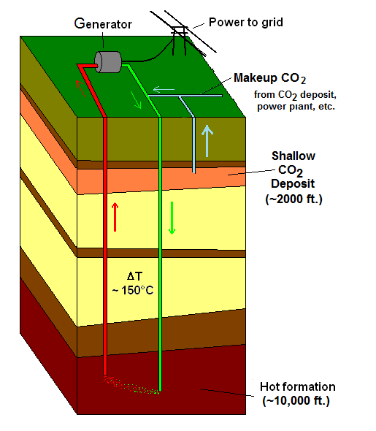
MAKE GEOTHERMAL ELECTRICITY FROM CO2 FROM AIR
Extracts heat 50% faster than with water-based geothermal
Does not require pumps or pumping
Can generate power with conventional technology (e.g., turbines)
Can store energy
Ideal for energy storage (e.g., less than 2-minute response time)
No separate storage technology required
Provides grid management capability
Baseload, firming or peaking power
“Firms up” wind or solar power
Produces carbon-negative power
Notes:
22

Slide 23
Geothermal Electricity + CO2
Collaboration with Green Fire Energy
Uses CO2 instead of water
20-50%% of circulating CO2 sequestered
Using CO2 captured from air
Location flexibility of air capture
Economic advantage of locating near use
Increased geothermal locations accessible
Produces Carbon Negative electricity

Slide 24
CONCLUSIONS
CLOSING THE CARBON CYCLE IS NEEDED FOR SUSTAINABILITY
NEED ABILITY TO CONTROL CO2 IN AIR OVER THE LONG TERM
NEED A GLOBAL THERMOSTAT( ANY AIR CAPTURE TECHNOLOGY)
WE NEED A WAY TO REFLECT EXTERNAL COSTS
CARBON LIMITS/CARBON MARKET
PRODUCING HYDROGEN ECONOMICALLY IS THE CHALLENGE
SUN THE SOURCE –COST NOT ENERGY EFFICIENCY IS THE CHALLENGE
CO2 FROM AIR IS A CRITICAL PART OF SOLUTION
$50/TONNE UNCOMPRESSED CAN BE ECONOMIC

